Slide 1
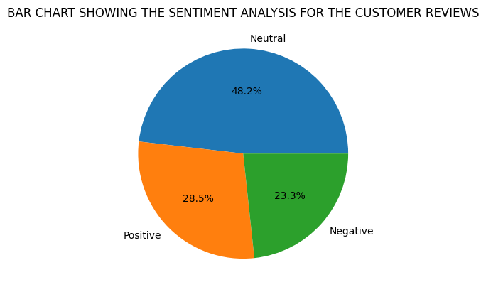
ANALYSING CUSTOMER REVIEW DATA FOR BRITISH AIRWAYS
Review data collection: used a python library called BeautifulSoup to scrape the data from the SKYTRAX website for 3,268 BA customer reviews.
Pre-processing & Cleaning: checked for missing entries; removing symbols and punctuations from words
Analysis: performed sentiment analysis using VADER (Valence Aware Dictionary and Sentiment Reasoner) to show if customer reviews are positive, negative or neutral.
The Bar chart shows that 1,757 customers found the services neutral while 1,041 customers were satisfied. However, 850 customers were unsatisfied (negative).

